Slide 1
Investigating key words in your text data with tf-idf
Drew Walker, MS, CHES,
Department of Behavioral, Social, and Health Education Sciences
Rollins School of Public Health
Notes:
DC: Maybe add in some learning objectives, could start the lesson with an opening question to get students engaged

Slide 2
By the end of this lesson, we’ll be able to
Explain in plain terms the term frequency-inverse document frequency method of analyzing text data.
Describe appropriate applications of tf-idf to multidisciplinary real-world research and analytic solutions.
Understand how to incorporate code examples of tf-idf analysis in R for our own research projects

Slide 3
Based on frequency alone, what are the most common words we read, speak, or hear?

Slide 4
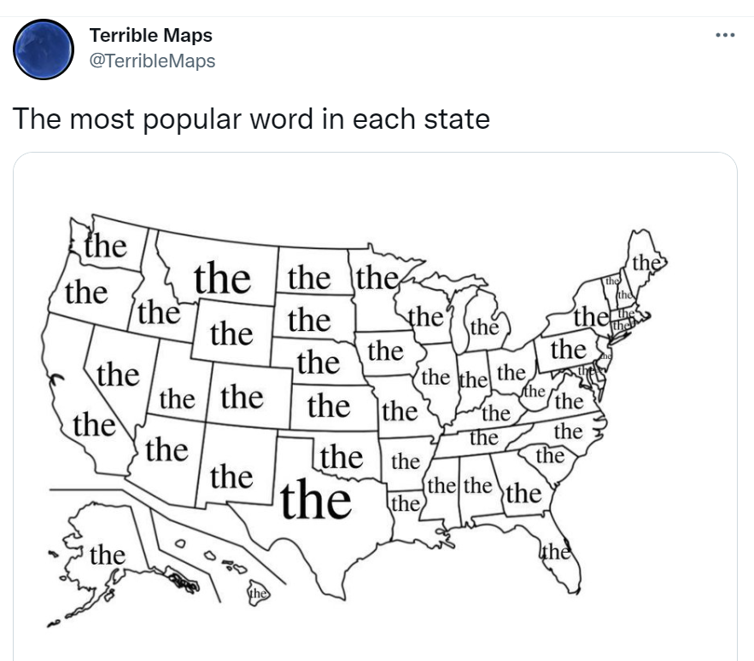
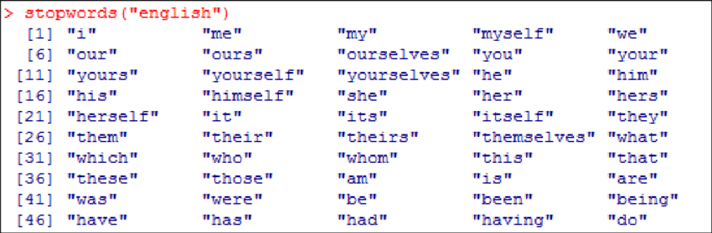
Stopwords
Notes:
For these types of analyses bag of words analyses– wordclouds especially are ruined by stopwords.
For many context-specific analyses like word embeddings, neural nets, stopwords are actually needed

Slide 5
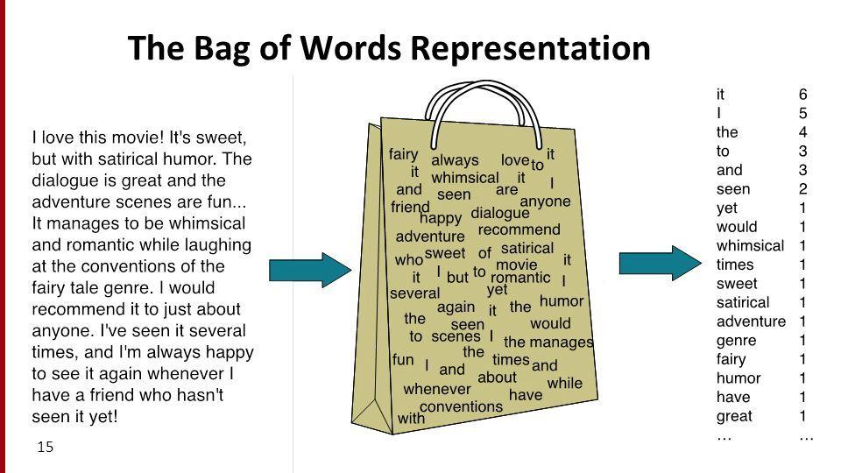

Slide 6
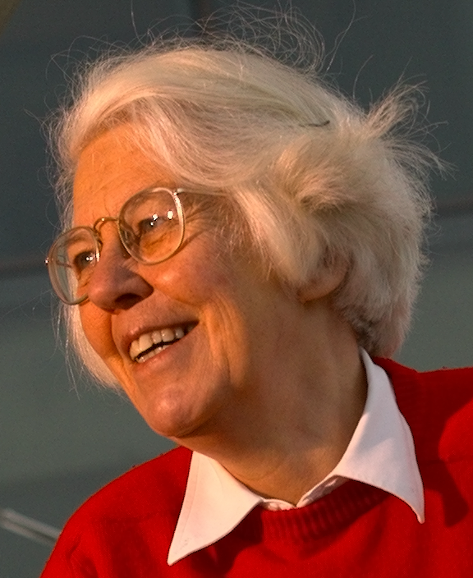
Term frequency – inverse document frequency (tf-idf)
Developed in 1972 paper by Dr. Karen Spärck Jones, pioneer for computational linguistics¹
Foundation for many (estimated over 80%) modern search engine and information retrieval systems
Term-frequency inverse document frequency is all about identifying the key words, or “word specificity” in different sets of documents.

Slide 7
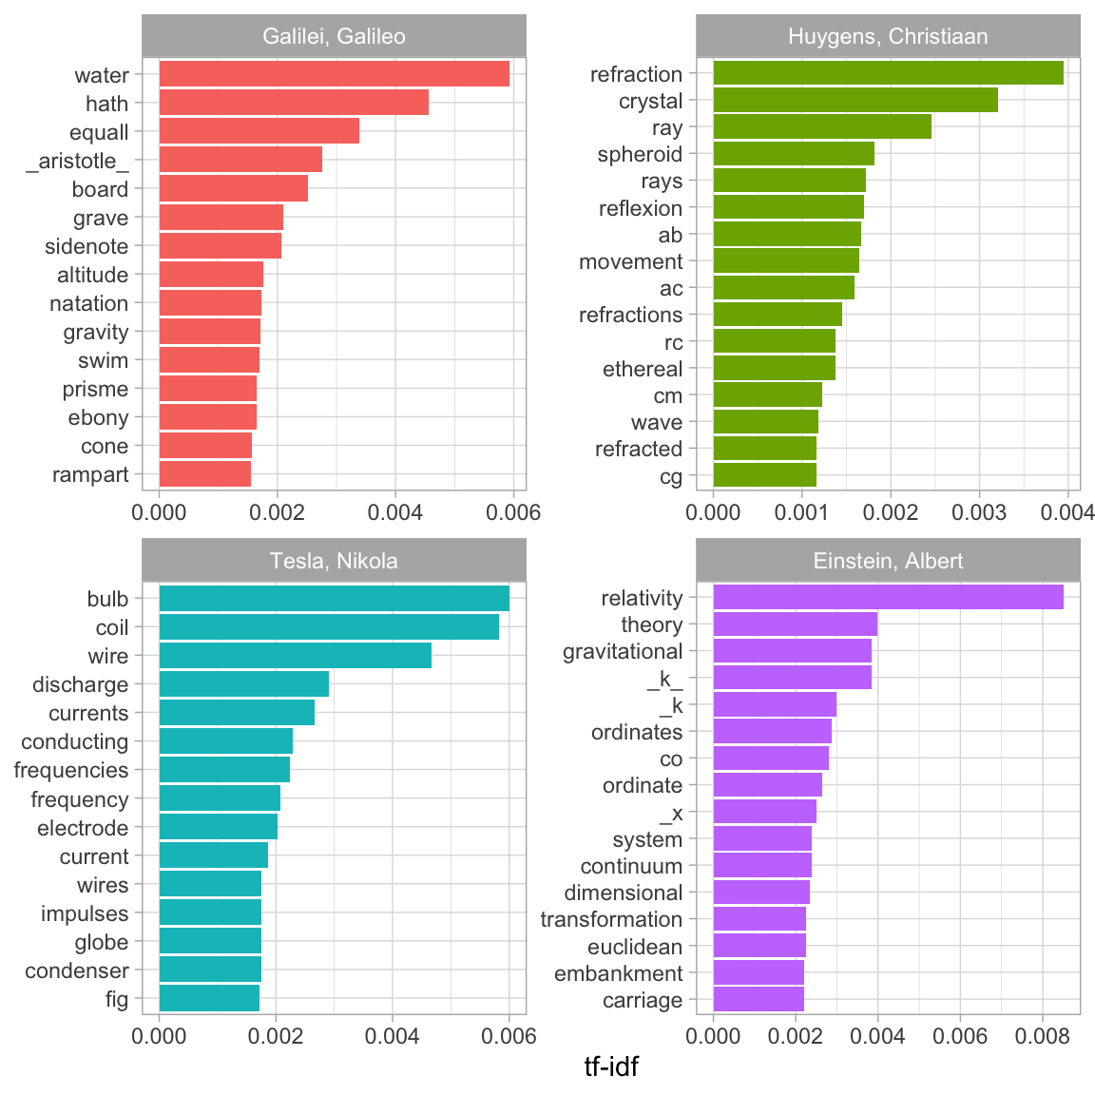
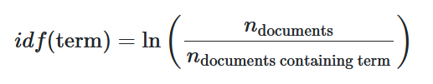
tf-idf = tf x idf
Calculated for each word in a collection.
tf = term frequency (word count)
The frequency of a specific term in a specific document
Multiplied by:
Idf =
the natural log of the ratio of number of documents/number of documents with that term.
This helps us weight unique words to each document or collection, and rule out common words.
Notes:
Tf-idf example from Julia Silge’s Text Mining with R: A tidy approach
https://www.tidytextmining.com/tfidf.html
Log is used to account for

Slide 8
Every field of study has its own shared language.
Partner up:
1) Introduce yourself and your dept/field of study.
2) What are some of the words that are specific to your department or field of study? (a high tf-idf)
3) What are some words you two might share? (a low tf-idf)
Notes:
These words would likely have a high tf-idf– they are present exclusively in each field, or at least far moreso than both or all fields combined.
What words would have low tf-idf? Very common words throughout both, often stuff like “the, and, as, but, with, so , etc.)

Slide 9
Let’s see what this might look like!
Web-scrape bios of our BSHES Faculty and PhD students (or copy-paste it ☺ )
Read data into R
Text pre-processing– remove punctuation, stop-words (only if you want)
Tokenize, or break texts into words
Count up overall totals of words in the overall corpus
Group by name
Total words per person
Calculate tf-idf
Visualize top tf-idf terms per person.
https://github.com/drew-walkerr/tf_idf_lesson

Slide 10
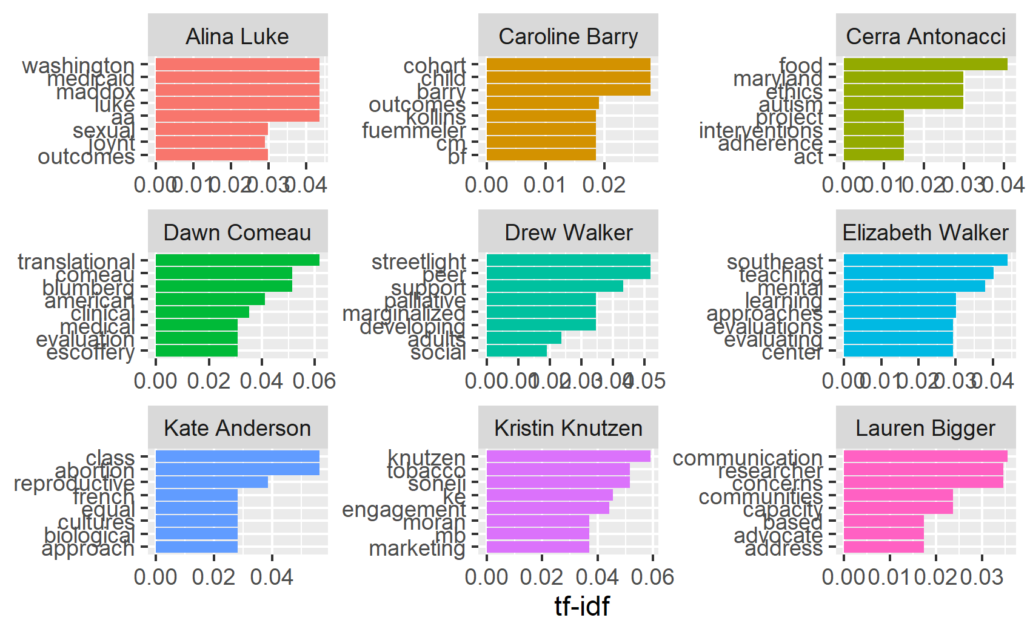
Notes:
CC: I LOVE THIS!!! ☺ ☺

Slide 11
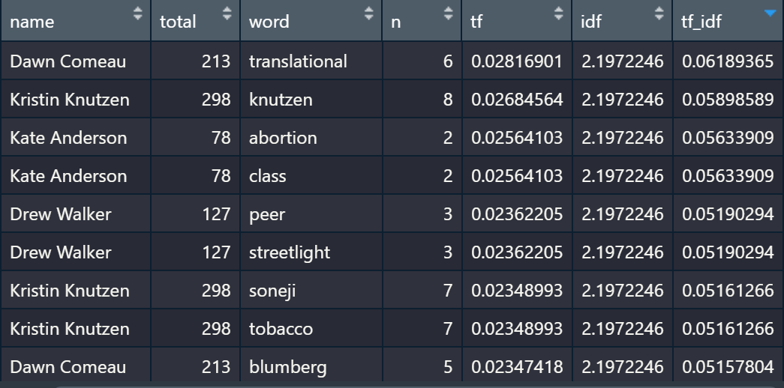
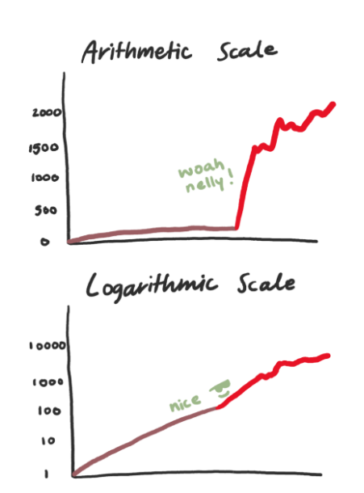
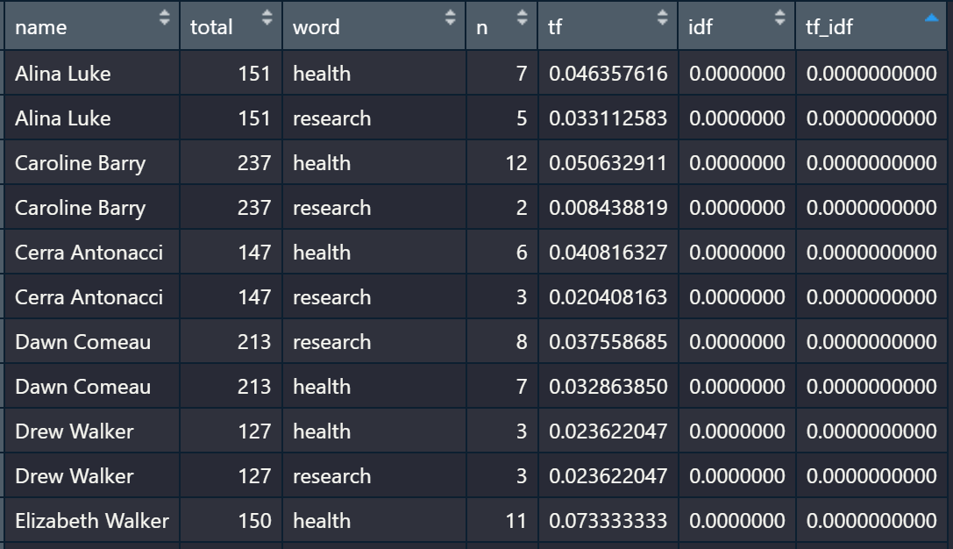
Why use logarithmic scale?
Notes:
Graph image source: Darla Maneja https://towardsdatascience.com/how-tf-idf-works-3dbf35e568f0

Slide 12
Examples of the (many) applications of tf-idf
Medical categorization tasks from clinical notes text data⁴
Evaluating key words in customer reviews (High vs Low ratings)⁵
Flu detection from Twitter text data⁶
Exploring lateral genetic transfer among microbial genomes⁷
Can be transformed as odds ratios for words appearing in different collections⁸
Identifying misinformation and fake news⁹

Slide 13

Further reading:
Text Mining with R by
Julia Silge and David Robinson
https://www.tidytextmining.com/

Slide 14
References
1. Spärck Jones K. A statistical interpretation of term specificity and its application in retrieval. Journal of Documentation. 2004;60(5):493-502. doi:10.1108/00220410410560573
2. Spärck Jones K. A statistical interpretation of term specificity and its application in retrieval. Journal of Documentation. 2004;60(5):493-502. doi:10.1108/00220410410560573
3. Silge J, Robinson D. Text Mining with R.; 2021. Accessed August 16, 2021. https://www.tidytextmining.com/index.html
4. Weng W-H, Wagholikar KB, McCray AT, Szolovits P, Chueh HC. Medical subdomain classification of clinical notes using a machine learning-based natural language processing approach. BMC Med Inform Decis Mak. 2017;17:155. doi:10.1186/s12911-017-0556-8
5. Shi H-X, Li X-J. A sentiment analysis model for hotel reviews based on supervised learning. In: 2011 International Conference on Machine Learning and Cybernetics. Vol 3. ; 2011:950-954. doi:10.1109/ICMLC.2011.6016866
6. Alessa A, Faezipour M. Tweet Classification Using Sentiment Analysis Features and TF-IDF Weighting for Improved Flu Trend Detection. In: Perner P, ed. Machine Learning and Data Mining in Pattern Recognition. Lecture Notes in Computer Science. Springer International Publishing; 2018:174-186. doi:10.1007/978-3-319-96136-1_15
7. Cong Y, Chan Y-B, Ragan MA. Exploring lateral genetic transfer among microbial genomes using TF-IDF. Sci Rep. 2016;6:29319. doi:10.1038/srep29319
8. Schnoebelen T, Silge [aut J, cre, cph, Hayes A. Tidylo: Weighted Tidy Log Odds Ratio.; 2020. Accessed August 16, 2021. https://CRAN.R-project.org/package=tidylo
9. Kapusta J, Drlik M, Munk M. Using of n-grams from morphological tags for fake news classification. PeerJ Comput Sci. 2021;7:e624. doi:10.7717/peerj-cs.624

